Slide 1
Unix Operating System
Introduction to Unix

Slide 2
History of Unix
In 1965, AT&T laboratories developed the MULTICS to provide remote access to computer and shared data
In 1969, Ken Thompson wrote the first version of Unix, called UNICS. (Uniplexed Operating and Computing System)
Ken Thompson teamed up with Dennis Ritchie, rewrote the Unix kernel in C

Slide 3
V1 The original release of UNIX
V3 The first version with program written in C(1973)
V4 Completely rewritten in C
V5 first version released for universities(1974)
V7 last of the original UNIX series(1979)

Slide 4
In 1979, UNIX development split in to two camps
AT&T continued with their work
University of California at Berkeley began the development of different UNIX system(BSD)
AT&T UNIX
Commercial version System III released in 1982
System V released in 1984

Slide 5
BSD UNIX
Commercial version BSD 4.2 released in 1983
BSD 4.4 released in 1993
Descendants of System V & BSD 4
AIX IBM AT &T
HP_UX HP AT&T
IRIX Silicon Graphics
Solaris Sun AT&T

Slide 6
A computer system
Hardware
  Input , output, CPU, auxiliary/secondary storage
Software
  Systems software
    Primary purpose to support computer
  Applications software
    Programs written to solve users problems

Slide 7
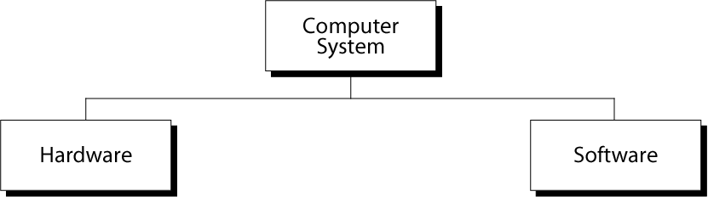
Computer System

Slide 8
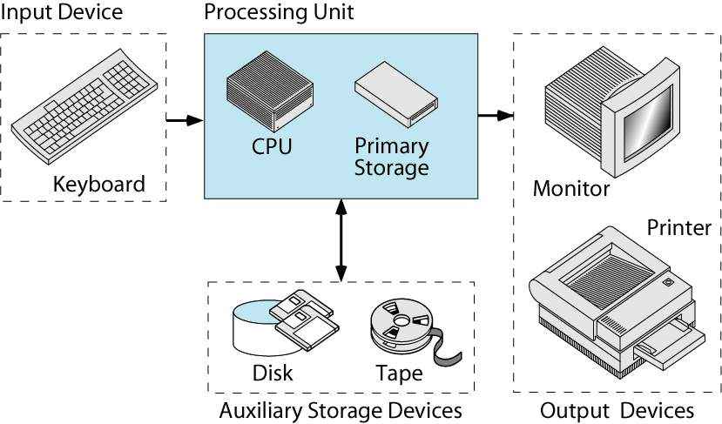
Components of Computer Hardware

Slide 9
Unix environments
Personal environment
  Linux, Apple’s System X (Unix kernel)
Timesharing environment
  Many users connected to one computer
Client/server environment
  Computing split between a central computer (server) and users’ computers (clients)

Slide 10
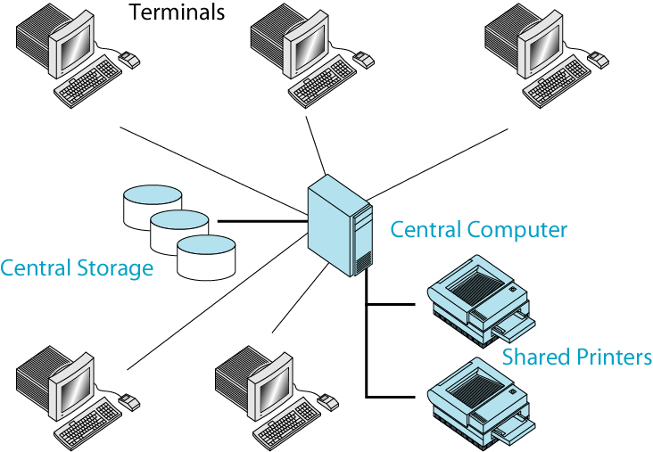
The Time-Sharing Environment

Slide 11
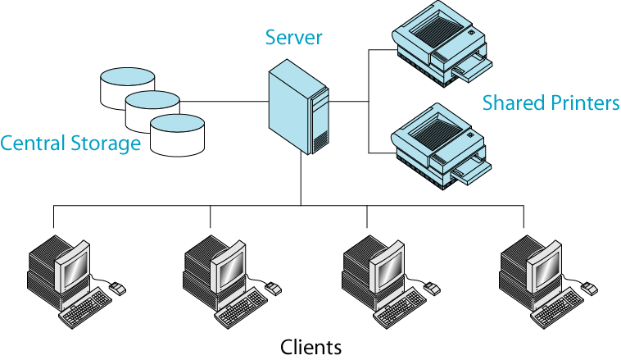
The Client/Server Environment

Slide 12
Main Features of UNIX
Multi-user
More than one user can use the machine at a time supported via terminals (serial or network connection).
The unix design allows multiple users to concurrently share hardware and software
The unix resource sharing algorithm allow them to share
resources while at the same time preventing any one from
locking out others
ie everone get equal chance at resources

Slide 13
Multi-tasking
More than one program can be run at a time.
More than one program can be running in the background while a user is working in the foreground
Organized File System
UNIX has a very organized file system that allows users to organize and maintain files
To support the organization and maintenance of files, the
file system is structured hierarchically

Slide 14
Networking
This capability is simply a part of the operating system
Networking allows users at one location to log in to systems at other site
Once access is gained to a remote system, users operate just as though they were on a system in their area
Device independence
Unix treats input/output device as ordinary files.
Input to a program can come from file and output of a program can go to a file

Slide 15
Portability
Unix was written in a machine independent language.
So Unix and Unix-like operating can run on a variety of hardware
Utilities
Programs that perform a single task
Utility programs provide the user with easily used productivity tools readily available with shot keyboard commands

Slide 16
Services
System administrators need support utilities to work with the system resources such as disk and security access
UNIX Provides support utilities for System administration and control

Slide 17
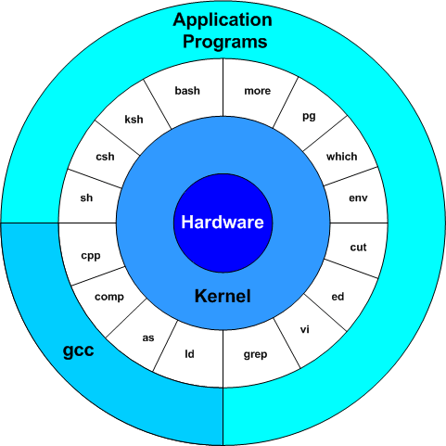
Architecture of UNIX

Slide 18
Hardware: This refers to the hardware layer of any computer system
Kernel: This sits on top of Hardware and it interacts with the hardware.
This is the core of the Operating system and acts as an interface between the user activities and the hardware.
It provides the base functionality of the OS.
The major functionality of the kernel includes process management, memory management, thread management, scheduling, I/O management and power management.

Slide 19
managing the machine's memory and allocating it to each process.
scheduling the work done by the CPU so that the work of each user is carried out as efficiently as is possible.
organizing the transfer of data from one part of the machine to another.
accepting instructions from the shell and carrying them out.
Enforcing the access permissions that are in force on the file system

Slide 20
Shell: This is an interface between the user and the kernel.
It interprets the commands from a user and executes the resulting request.
Post processing the commands kernel returns back the instructions to the shell.
There are various types of command line shells in Unix: Bourne Shell, C Shell, Korn Shell, Bourne Again Shell (bash).
User: communicates with Shell through Commands.

Slide 21
Utilities
Utilities are programs that provides a support process for users
    Eg: file management (rm, cat, rmdir, mkdir)
  user management (passwd, chmod)
  process management (kill, ps)
Applications(Application Programs)
  Programs that are not a standard part of UNIX
  Written by programmers or users
  Eg: web browsers, media player

Slide 22
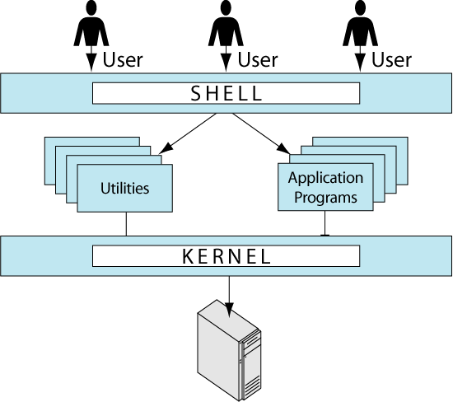
Components of UNIX

Slide 23
What Is Shell?
With UNIX, the command interpreter or command line interface is called shell. It is the interface between user and kernel.
Several different shells are available. The most common ones are:
  sh: The Bourne shell. It is available for all UNIX system.
  csh: The C shell. The most popular shell developed at Berkeley.
  ksh: The Korn shell which is compatible with sh, but it has most of C shell’s features plus some completely new features.
  bash: It is the shell in the GNU (not UNIX) operating system.

Slide 24
How the Shell Interprets the Commands
User
User
commands
and data
Interactive
commands
handle
prompt
Output
Output
Shell
cat
ls
vi
Spawn
processes
and transfer
control
Build-in commands
Requests
for services
UNIX Kernel and Device Driver
Relationship between Kernel, Shell, Utilities, and Applications

Slide 25
Contd…
As an illustration of the way that the shell and the kernel work together, suppose a user types rm myfile (which has the effect of removing the file myfile).
The shell searches the file store for the file containing the program rm, and then requests the kernel, through system calls, to execute the program rm on myfile.
When the process rm myfile has finished running, the shell then returns the UNIX prompt % to the user, indicating that it is waiting for further commands.

Slide 26
Accessing UNIX
Log in to the system before doing any work.
Once you are logged in , you enter commands and the system responds
Log out after finishing work
The time spent working with the system is known as session

Slide 27
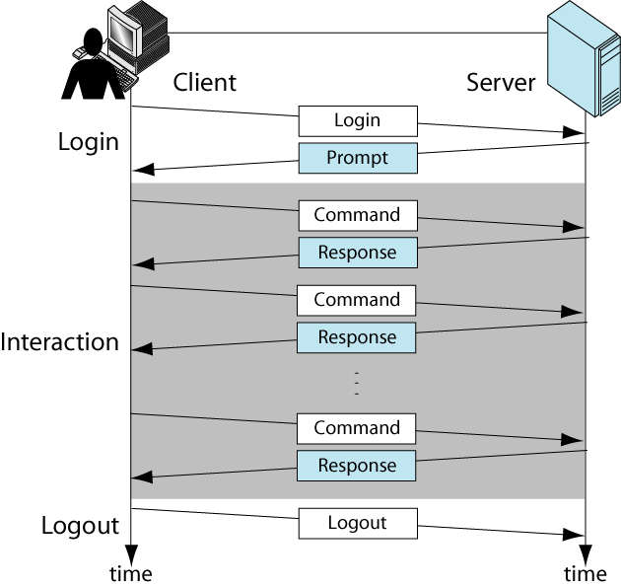
Interactive Session

Slide 28
Unix Commands
Command is an action request given to the Unix shell for execution
Single line entered at the command prompt that cause a program or shell script to be executed
Commands apply an action on to some input data and create some output data
Input can come from the keyboard or file
Output can go to the monitor or to a file or to a printer

Slide 29
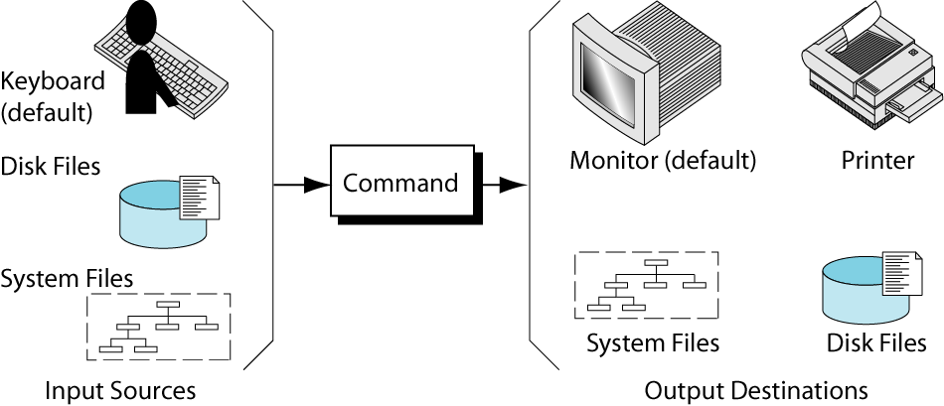
Command Source and Destination

Slide 30
UNIX Command Structure
Basic syntax of UNIX commands:
  command _name options argument(s)
command _name | indicates what action to be taken
options | modifies the function. options are usually one character preceded by a minus sign
arguments | provides additional information to the command

Slide 31
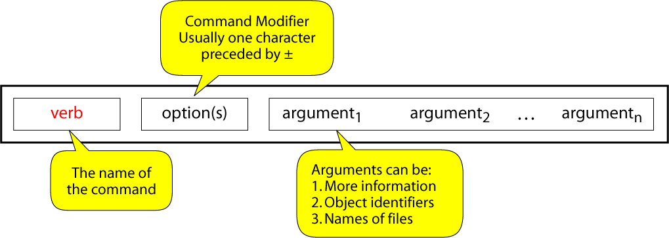
General Command Format

